Slide 1
Introduction to Data Science
Machine Learning University – Class 5

Slide 2
Agenda
Quiz 4
Review
Data Collection
Using ML Models in Production
Course Review
Finals Week

Slide 3
Quiz 4

Slide 4
Agenda
Quiz 4
Review
Data Collection
Using ML Models in Production
Course Review
Finals Week

Slide 5
Last Time
Model Debugging
Validation Set
Learning Curves
Error Analysis
Model Tuning
Regularization
Setting Hyperparameters: Validation Curves and Grid Search
Training Data and Feature Set Tuning

Slide 6
Agenda
Quiz
Review
Data Collection
Sampling
Labeling
Using ML Models in Production
Course Review
Finals Week

Slide 7
Data Collection
Data Collection: Process of acquiring training and/or test data
Motivation
Initial datasets for training models and measuring success
Additional data for tuning
Replacements for flawed or outdated sets
Data and model maintenance post-production
Sources
Logs
Databases
Web sites (crawling and scraping)
Data providers (public or private)
etc.

Slide 8
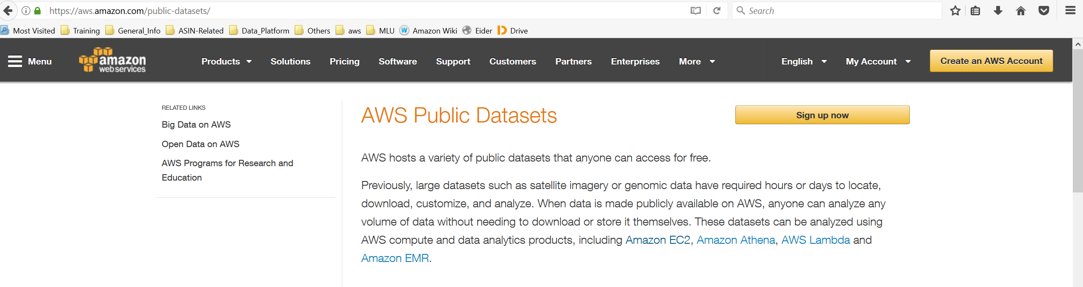
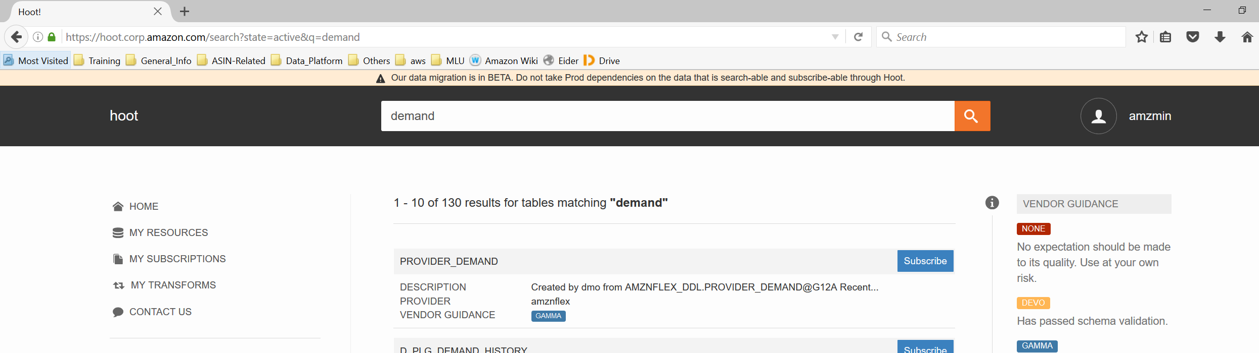
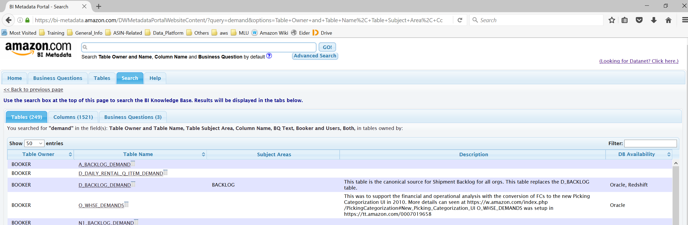
Public datasets
Amazon internal
Datasets and tables
Internal tables
on Datanet

Slide 9
Data Collection
Sampling: Selecting a subset of instances for training and testing
Labeling: Obtaining gold-standard answers for supervised learning
Terminology: Instance = example = data point

Slide 10
Sampling
Representativity: Sample needs to be representative of the expected production population; i.e., unbiased
Especially important for testing and measurement sets
Often important for training sets also to get good generalization
Random sampling: Sampling so each source data point has equal probability of being selected

Slide 11
Stratified sampling
Issue: With random sampling, rare subpopulations can be under-represented (or not at all!)
A subpopulation is defined usually as examples with the same label.
Stratified sampling: Apply random sampling to each subpopulation separately.
Usually, the sampling probability is the same for each stratum.
If not, weights can used in metrics, and/or directly in training

Slide 12
Other issues with sampling
Seasonality: Time of day, day of week, time of year (e.g., seasons), holidays, special events, etc.
Stratified sampling across these can minimize bias
Visualization can help
Trends: Patterns can shift over time, new patterns can emerge
To detect, try comparing models trained over different time periods
Visualization can help
Consider using validation data later in time than training data

Slide 13
Leakage
Train/test bleed: Inadvertent overlap of training and test data when sampling to create datasets
Sample from fresh data
Filter out already selected instances
Partition source data along some dimension (but avoid bias)
Be especially careful with time-series data and data with duplicate entries
Leakage: Using information during training or validation that is not available in production.
Kaufman, Shachar, et al. Leakage in data mining: Formulation, detection, and avoidance. ACM Transactions on Knowledge Discovery from Data (2012): 15.

Slide 14
Labeling
Motivation: Often, labels not readily available in sampled data
Examples
Search: The results a customer wanted to receive
Music categorization: The genre of a piece
Sentiment analysis: The overall attitude of the writer
Digitization: The transcription of handwriting
Object detection: The localization of objects in images
Sometimes labels can be inferred, e.g., from click-through data
Human labels can be preferable to minimize bias, capture subtleties, etc.

Slide 15
Labeling Components
Labeling guidelines: Instructions to labelers
Critical to get right
Minimize ambiguity
Labeling tool
Technology: From Excel spreadsheet to Mechanical Turk to custom-built tool
Questions: Human Intelligence Tasks (HITs) should be simple and unambiguous
Poor design of either can impact labeler productivity and quality, and can introduce bias

Slide 16
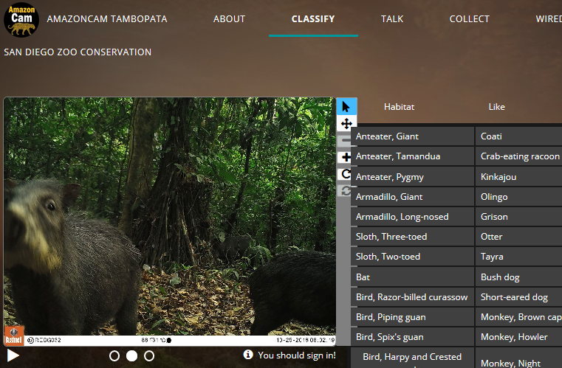
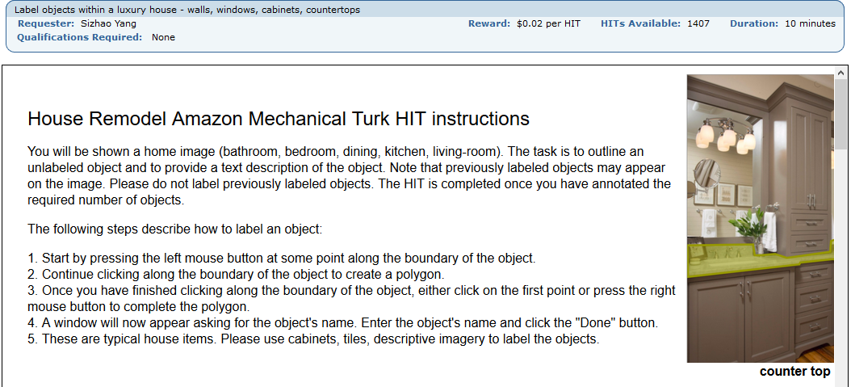
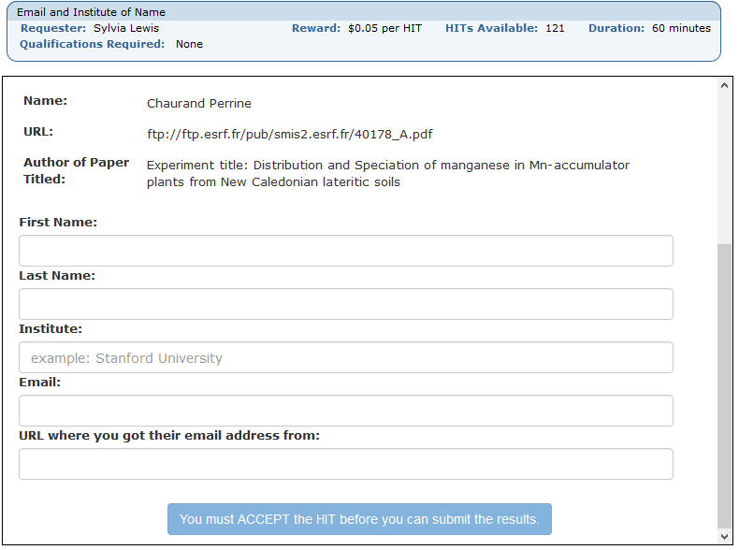
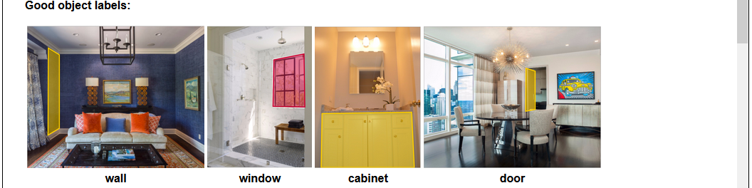
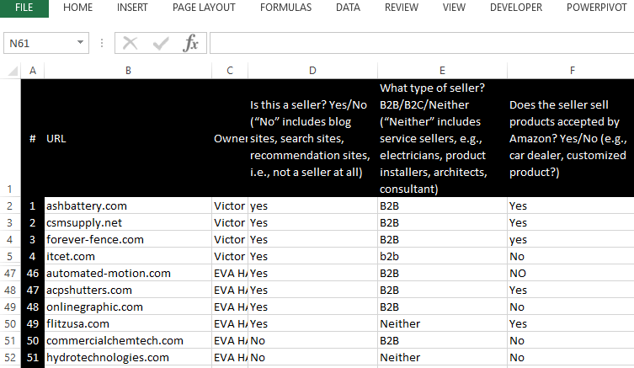
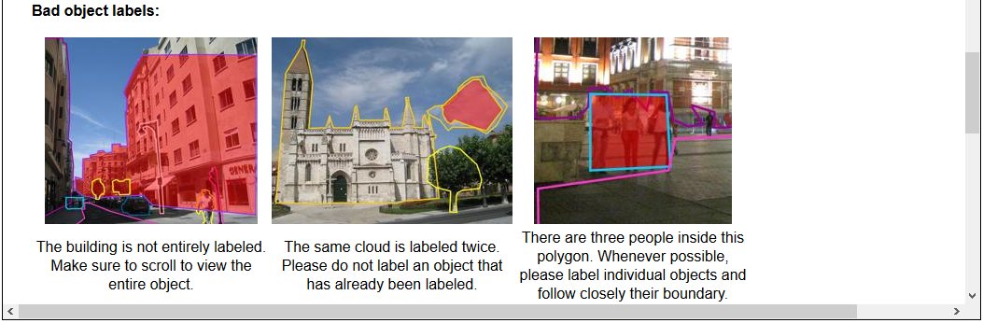
Labeling Tools

Slide 17
Managing Labelers
Motivation: Bad labels => poor ML results
Duplication: Assign each HIT to multiple labelers to identify difficult or ambiguous cases, or problematic labelers (lazy, confused, biased, etc.)
Gold Standard HITs: HITs with known labels mixed in to identify problematic labelers
Auditors: Experts that adjudicate labeler disagreements and/or sample results for quality
Labeler Incentives: compensation, rewards, voluntary, gamification
Quality and productivity metrics: can help detect problems with labelers

Slide 18
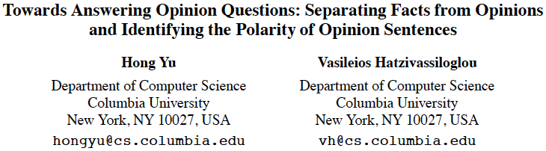
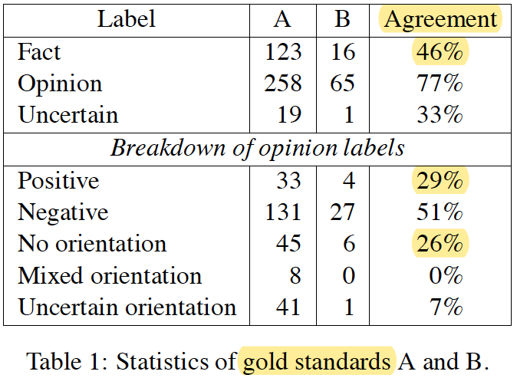
An example on human labeling…

Slide 19
Sampling and Treatment Assignment
 | Random Assignment | No Random Assignment
Random Sampling | Ideal experiments: causal conclusion and can be generalized (rarely available in traditional analysis, but become available in online testing) | Typical survey or observation studies: cannot establish causation, but can find correlation and can be generalized (additional work needed to infer causation) | Generalization
No Random Sampling | Most experiments: causal conclusion for the sample only (more work is needed to generalize) | Badly-designed survey or pooled studies: cannot establish causation, cannot generalize to larger population (more work is needed to draw useful conclusions) | No Generalization
 | Causation | Correlation

Slide 20
Agenda
Review
Data Collection
Using ML Models in Production
Life Cycle of Machine Learning in Production
Aspects to consider
ML Models in Production at Amazon
Course Review
Finals Week

Slide 21
Productionization
Integrating an ML solution with existing software, and keeping it running successfully over time.

Slide 22






Life Cycle of Machine Learning in Production
ML-model should be treated the same as other parts of your system:
Adding functionalities
Introducing dependencies
Current status:
Lack of system-level standardized tooling
Lack of standardized language across problem domains
No “one-size-fits-all” (well, similar to the no-free-lunch theorem).

Slide 23
Aspects to consider
Production environment
Production scenarios
Code to provide low-latency and/or high-volume predictions
Data format and storage
Production-oriented modelling
Production-focused model integration
Quality monitoring
Data and model security
Customer obsession

Slide 24
Production environments
Batch predictions
Useful if all possible inputs known a priori (e.g., all ASINs for which demand is to be forecast, all keywords to bid)
Predictions can still be served real-time, simply read from pre-computed values
Online predictions
Useful if input space is large (e.g., customer’s utterances or photos, detail pages to be translated)
Low latency requirement (e.g., at most 100ms)
Online training
Sometimes training data patterns change often, so need to train online (e.g., fraud detection)

Slide 25
Aspects to consider
Production environment
Production-oriented modelling
Data storage formats
Model storage and versioning
Reproducibility of training
Debugging of training and predictions
Connection with data, codes, libraries etc.
Production-focused model integration
Quality monitoring
Data and model security
Customer obsession

Slide 26
Data Storage Formats
Row-oriented formats:
Comma/Tab-Separated Values (CSV/TSV)
Read-Only DB (RODB): internal read-only file-based store with fast key-based access
Avro: allows schema evolution for Hadoop
Column-oriented formats:
Parquet: type-aware and indexed for Hadoop
Optimized Row Columnar (ORC): type-aware, indexed, and with statistics for Hadoop
User-defined formats:
JavaScript Object Notation (JSON): for key-value objects
Hierarchical Data Format 5 (HDF5): flexible data model with chunks
Compression can be applied to all formats
Usual trade-offs: read/write speeds, size, platform-dependency, ability for schema to evolve, schema/data separability, type richness

Slide 27
Model and pipeline persistence
Custom methods:
Scikit-learn: Uses python’s pickle method to serialize/deserialize Python objects
Spark MLlib: Transformers and Estimators implement MLWritable
TensorFlow (deep learning library): Allows saving of MetaGraph
MxNet (deep learning library): Saves into JSON
Deep learning methods can use ONNX to share models across different platforms (https://onnx.ai/)

Slide 28
Aspects to consider
Production environment
Production-oriented modelling
Production-focused model integration
Model deployment
Service-specific model development
Pipelines to provide features
Model testing, modification and plugging/unplugging
Model metrics vs. product metric
Quality monitoring
Data and model security
Customer obsession

Slide 29
Model Deployment
Technology transfer: Experimental framework may not suffice for production
A/B testing or shadow-testing: Helps catch production issues early
Weblab: Experiment platform for A/B testing for measuring causal impact of changes
Zinkevich, Martin. Rules of Machine Learning: Best Practices for ML Engineering. (2017).

Slide 30
Aspects to consider
Production environment
Production-oriented modelling
Production-focused model integration
Quality monitoring
Performance monitoring
Bug detection
Integrating new data
Model maintenance
Data and model security
Customer obsession

Slide 31
Monitoring and Maintenance
Important to monitor quality metrics and business impacts with dashboards, alarms, user feedback, etc.:
The real-world domain may change over time.
The software environment may change
High profile special cases may fail
Change in business goals
Performance deterioration may require new tuning:
Changing goals may require new metrics
A changing domain may require changes to validation set
Validation set may be replaced over time to avoid overfitting

Slide 32

Aspects to consider
Production environment
Production-oriented modelling
Production-focused model integration
Quality monitoring
Data and model security
Classification level setting
Internal & public data
Customer’s data
Customer obsession

Slide 33
Information Security
Need to make sure handling of training and evaluation data is in accordance with data classification
Models may need to be treated with same classification level as source data.

Slide 34

Aspects to consider
Production environment
Production-oriented modelling
Production-focused model integration
Quality monitoring
Data and model security
Customer obsession
What do we want to deliver via ML?
How would customers feel about this?
Identify the possible mis-alignments
Not only the result, but also how to handle data
Customer privacy, fairness, and trust

Slide 35


Slide 36
Customer Obsession
Think carefully about impacts on customer perception and trust
Example: Facebook’s personalized ads led to accusations of racism (https://www.wired.com/2016/11/facebooks-race-targeted-ads-arent-racist-think/)
Give ML solutions the “creepiness sniff test” and “New York Times front page test”
Provide explanations to customers

Slide 37
Productionization at Amazon
No single commonly used infrastructure at this point
Model Factory: Ecosystem to simplify access to data to enable analysis, visualization, insight generation, model building, and productionization
Model Builder and Deployer: Productionization component
Eider: Experimentation component via notebooks
Feature Repository: Storage component for features
Ryck/Experiment Tracker: Storage component for ML artifacts

Slide 38
Productionization at Amazon
Elastic Machine Learning (EML): Amazon’s older ML platform; train, predict, evaluate, and productionize models by specifying recipes
Amazon AI: Family of AI and ML services
Amazon Machine Learning (AML): External-facing subset of EML (de-emphasized)
Rekognition: Deep learning-based image recognition
Lex: Deep learning-based automatic speech recognition and natural language understanding (powered by Alexa)
Polly: Deep learning-based speech synthesizer
Future: General-purpose ML training and deployment tools

Slide 39
SageMaker
The most recent ML deployment platform in Amazon, as well as provide as service to AWS users
Great support for internal users
https://w.amazon.com/index.php/AWS/AmazonAI/Platform/Get%20SageMaker%20Support
Internal integration with Eider and Amazon internal dataset
https://w.amazon.com/index.php/Eider
https://eider.corp.amazon.com/published/notebook/output/NB1IWVBU4T
Many talks about SageMaker at AMLC 2018:
https://w.amazon.com/index.php/AMLC2018/url%3AIntroduction%20to%20Amazon%20SageMaker
https://w.amazon.com/index.php/AMLC2018/url%3ASageMaker%20and%20Algorithms

Slide 40
Using SageMaker for production
Upload training data
Create Jupyter Notebook instance
Upload the model and helper function files
Set up the inference in Lambda and API Gateway services
Invoke the API
https://aws.amazon.com/blogs/machine-learning/call-an-amazon-sagemaker-model-endpoint-using-amazon-api-gateway-and-aws-lambda/
SageMaker is certified for up to Red (Critical Data) data. SageMaker was approved by CDO InfoSec back on 01/11/2019.

Slide 41
Other Internal ML Platforms
Recommendations Modeling Team (ReMo)
DSSTNE: Neural Network Engine
EDLS/Mesos: Orchestrator for Docker/ECS based jobs on GPU hardware
Scylla: Declarative API for specifying ML pipelines
RemoKeras: Theano interfaced with Keras for deep learning experimentation
Diapason/Docker: Hyperparameter tuning
Tarot: Algorithm baseline platform
Pirama: Experiment Manager and Leader Board

Slide 42
More Internal ML Platforms and Systems
Wupper: Time-series forecasting at scale
Alexa Machine Learning Platform/Hoverboard: Alexa ecosystem
Continual Seller Monitoring Service (COSMOS): Reactive risk evaluation service offering workflows that follow five logical steps – gather variables, Models, Rules, Actions, and Publishers
Neural Motor (NeMo): Focused on deep learning
Flint: Facilitates going from experimentation to productionization using Spark on EMR
Risk Analytics Platform (RAP): Multi-tenant platform with focus on data certification
Distributed Job Scheduler (DJS): Popular for scheduling workflows
Aegis: Job orchestrator for Spark-based applications on EMR
Glue: Data integration service for managing ETL jobs

Slide 43
Agenda
Quiz
Review
Data Collection
Productionization
Course Review
ML Algorithms
Finals Week

Slide 44
Where do you go from here in MLU?
Supervised
Linear
Decision Tree and Ensemble Methods (DTE)
Neural Networks
Feed-forward Neural Networks (FFNN)
Recurrent Neural Networks (RNN)
Text Mining
Convolutional Neural Networks (CONV)
Natural Language Processing
Linear and Logistic Regression (REGR)
Large-scale Linear Models (LSM)
Topic Models
Clustering and Mixture Modeling (CMM)
Matrix Factorization and Dimensionality Reduction (MFDR)
Unsupervised
Parallel and Distributed ML (PDML)
Productionization
Reinforcement
Reinforcement Learning (RL)
Deep Reinforcement Learning (DRL)
AMLC (Amazon Machine Learning Conference)
Videos on Broadcast (https://broadcast.amazon.com/search?q=amlc)
Posters and Papers (https://w.amazon.com/index.php/AMLC_2019)

Slide 45
Common Mistakes in ML Projects
Solve the wrong problem
Data was flawed
Solution didn’t scale
Final result doesn’t match with prototype’s results
Takes too long to fail
Solution too complicated
Not allocated engineering resources to try out long-term science ideas
Off balance -- lack of a true collaboration
* This slide is adopted from AMLC 2017 presentation: link

Slide 46
Agenda
Quiz
Review
Data Collection
Productionization
Course Review
Finals Week
Final Reading Assignment
Final Exam
Final Project Presentation

Slide 47
Final Reading Assignment
Random sampling: https://en.wikipedia.org/wiki/Simple_random_sample
Stratified sampling: https://en.wikipedia.org/wiki/Stratified_sampling
Handling imbalanced data: http://machinelearningmastery.com/tactics-to-combat-imbalanced-classes-in-your-machine-learning-dataset/
Mechanical Turk Good Practices: http://mturkpublic.s3.amazonaws.com/docs/MTURK_BP.pdf
Model Factory’s Model Builder and Deployer (MBD): https://w.amazon.com/index.php/Model%20Factory/Model%20builder
Elastic Machine Learning (EML): https://w.amazon.com/index.php/Elastic_Machine_Learning
POA talk: Machine Learning in Real Life

Slide 48
Final Exam
Time: 10:00am – 11:00am
Open book, individual
Questions: Short answers, like the quizzes
Definitions
Comparisons
Options and tradeoffs
Usage (“In situation X, which technique would be most appropriate?”)
Some questions may have multiple parts
Topics: Everything covered in class (weeks 1-5)

Slide 49
Final Exam Topics
Week 1: Overview of data science and machine learning
Week 2: Problem formulation, exploratory data analysis, model evaluation
Week 3: Data preprocessing, feature engineering
Week 4: Outlier handling, model tuning and debugging
Week 5: Data collection and productionization
https://mla.corp.amazon.com/ml-and-natural-language-processing/natural-language-processing-amazon-101-day-4/mlnlp-production-sagemaker/

Slide 50
Final Project Presentation and Report
Time: 11:00am – 12:00pm
Attendance: Everyone
Who: Top 5 on Private Leaderboard
When Closes: Midnight UTC two business days before class
Length: 5-10 minutes each team (+5 minutes for Q&A)
Presentation and Report Content:
Problem description, motivation, metrics (be brief!)
Approach taken and and justification of choices
Design of experiments
Results of experiments
Analysis, interpretation and explanation of the results
Lessons learned

Slide 51
“ALL models are wrong, but some are useful.” We CAN build useful ML models and use them within certain domains. Thank you! And PLEASE take the survey (help label data for MLU).

